Slide 1
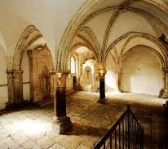
Acts 1: 13: We entered the Upper Room
We showed up…

Slide 2
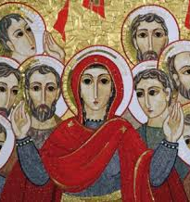
Acts 1:14 All devoted themselves in one accord to prayer

Slide 3
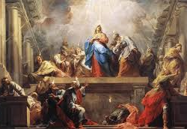
Acts 2: 1-4
Then, the Holy Spirit
showed up!

Slide 4
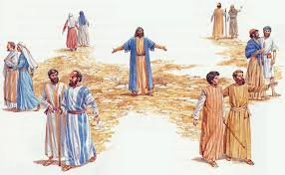
Acts 1:8 … you will be My witnesses…

Slide 5
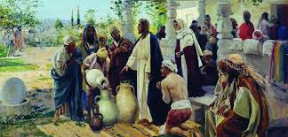
Do whatever He tells you…John 2: 5
Notes:
Do what He’s told you to do – ponder the message you've received in your heart
Hopefully, you will be discussing what you’ve heard here…. This is what the Lord’s giving to sustain, encourage, and lead you till we meet again in 2021.
Get involved away from just the Meal – bible study, LIS, prayer group
We need to keep the fire stoked -

Slide 6
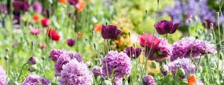
Be a fragrant flower in Mary’s garden!
Bloom where you’re planted!
Notes:
Bloom where you’re planted

Slide 7
Bloom Where You’re Planted Rev. Carey Landry
Look at the flowers, look at them growing; they never worry; they never work; yet look at the way our Father clothes them, each with a beauty all of its own
Some plant the seeds that others ill water, but in all things, God gives the growth. Come, let Him garden the flowers within you; come and discover some you’ve never known.
Look at the love that lies deep within you. Let yourself be! Let yourself be! Look at the gifts you have been given. Let them go free. Let them go free.
Bloom, bloom, bloom where you’re planted. You will find your way.
Bloom, bloom, bloom where you’re planted. You will have your day.

